Slide 1
LUNG CT IMAGE TUMOR SEGMENTATION FOR NON-SMALL-CELL
LUNG CANCER USING DEEP LEARNING
Roy Huang, Daniel Meggo, Jordan Mimms
December 5, 2024

Slide 2
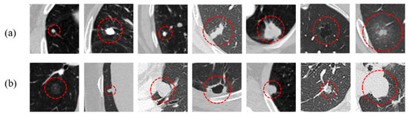
Introduction
Leading cause of cancer-related deaths and most common form of cancer¹
Non-Small Cell Lung cancer accounts for 80% of cases²
Accurate detection and diagnosis are critical to patient outcomes
Manual segmentation is labor intensive and time consuming

Slide 3
Introduction
U-Net Architecture shows great efficiency for segmentation
The selection of an appropriate loss function is critical for segmentation accuracy.
Goal of the study:
Compare segmentation accuracy between Dice and Focal loss functions when using the U-Net architecture for lung nodule segmentation.

Slide 4
Dataset
Dataset Source
Data pre-processing³
Saeid Rasouli, MD³
Originally sourced from Medical Segmentation Decathlon⁴
Chest CT images of 63 subjects.
Preprocessed into numpy arrays.
Normalized intensities to [-1, 1]
Cropped to lung region
3D CT Scans split into 2D slices
2D slices resized to (256, 256)
Final: preprocessed numpy files

Slide 5
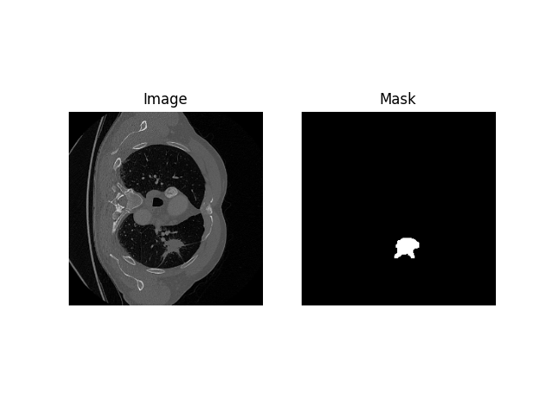
Dataset
Ground Truth Reference
Dataset also contained segmentation masks for lung cancer nodules.
We used these as our ground truth reference
Slice
Lung Cancer Mask

Slide 6
Dataset
62 Patients
15767 2D CT slices
1648 cancerous slices
Ground Truth
Masks
Training set
70%
1153 cancerous slices
Validation set
15%
247 cancerous slices
Testing set
15%
248 cancerous slices

Slide 7
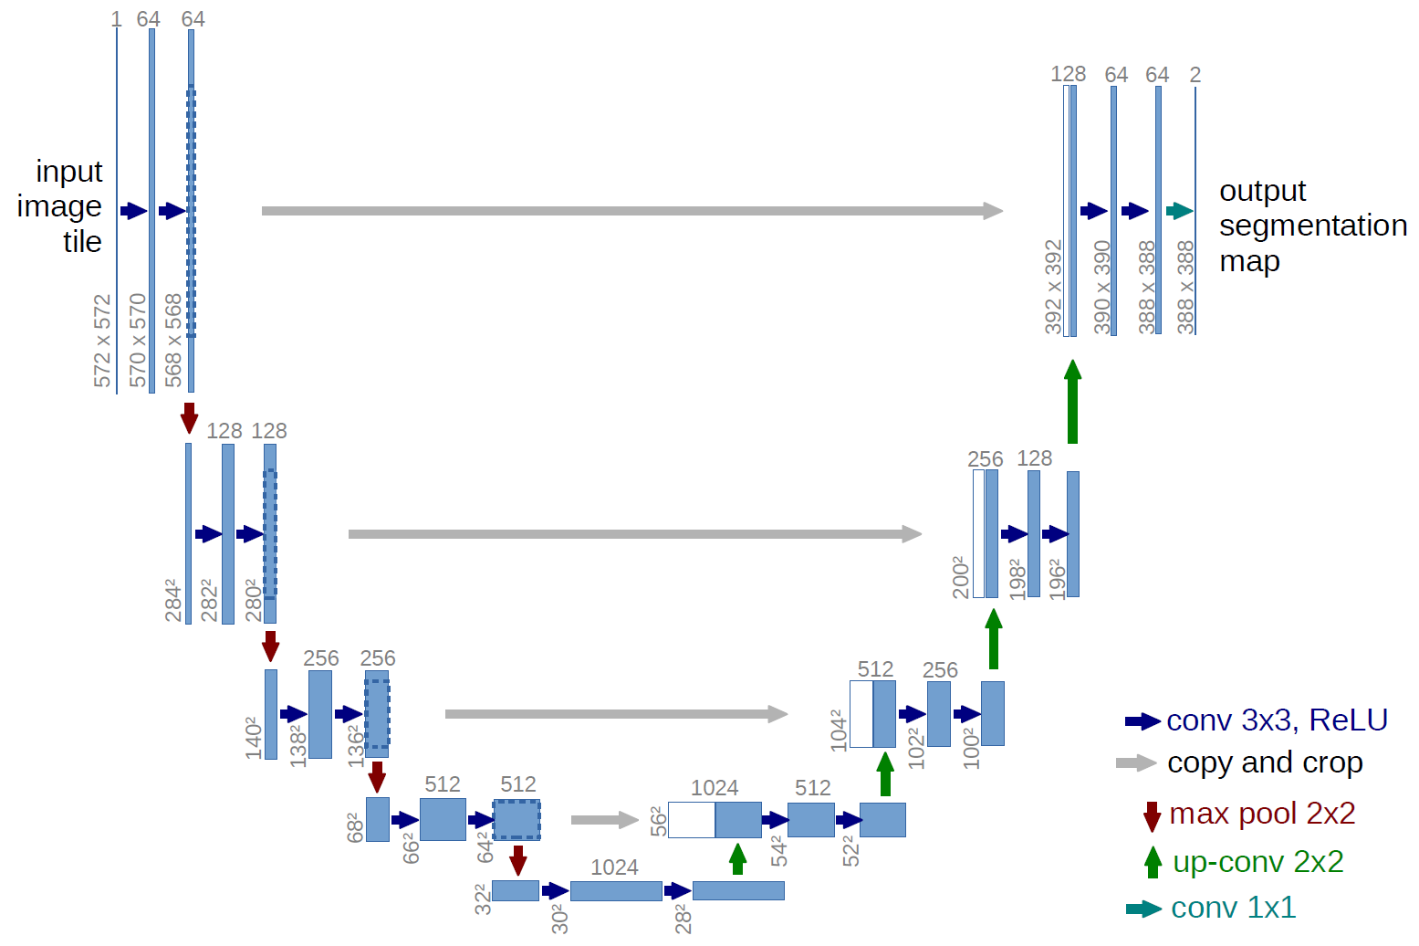
Model
U-Net Architecture diagram⁵

Slide 8
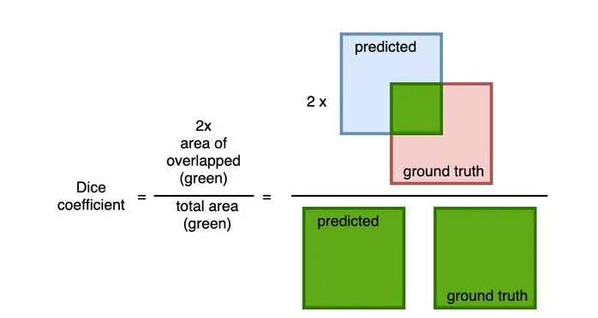
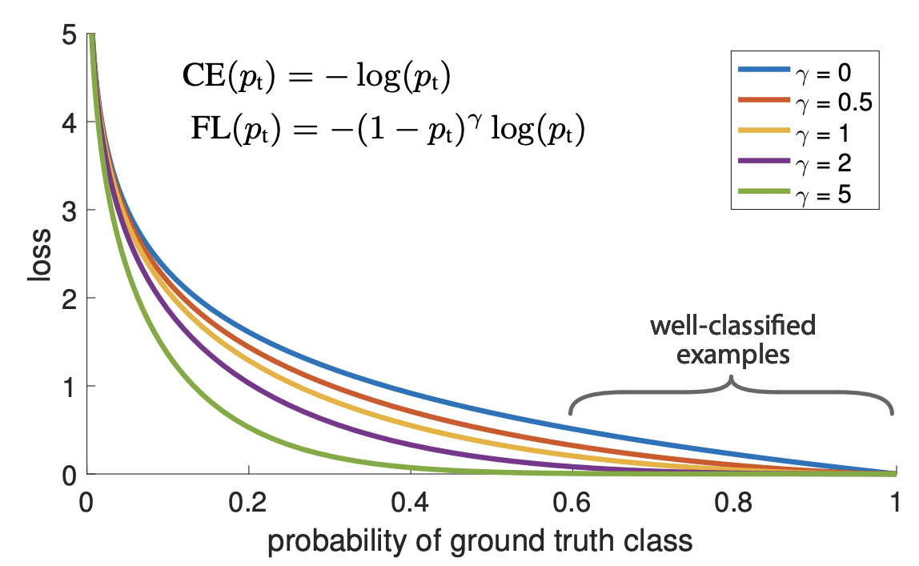
Loss Functions
Dice Loss
Focal Loss
Dice + Focal Loss
Measure similarities between model output and ground truth
Focus on positive mask regions, dealing with small tumor sizes
Combination of the Dice and Focal loss functions
Figure: Dice Loss diagram⁶
Figure: Focal Loss diagram⁷

Slide 9
Approach
Model 1
Unet
Dice+Focal (Combo)
Model 2
Unet
Layer Normalization
Dice+Focal (Combo)
Model 3
Unet
Layer Normalization
Dice
Model 4
Unet
Layer Normalization
Focal

Slide 10




Training Process
Data augmentation
Automatic stoppage
Learning rate schedulers
Layer normalization
50% flip along x
50% flip along y
50% noise added
50% rotate 90°
Patience =10
Patience =1
Adjustment = 0.9
Notes:
Download the full brand icon set at brand.uiowa.edu/graphic-elements

Slide 11
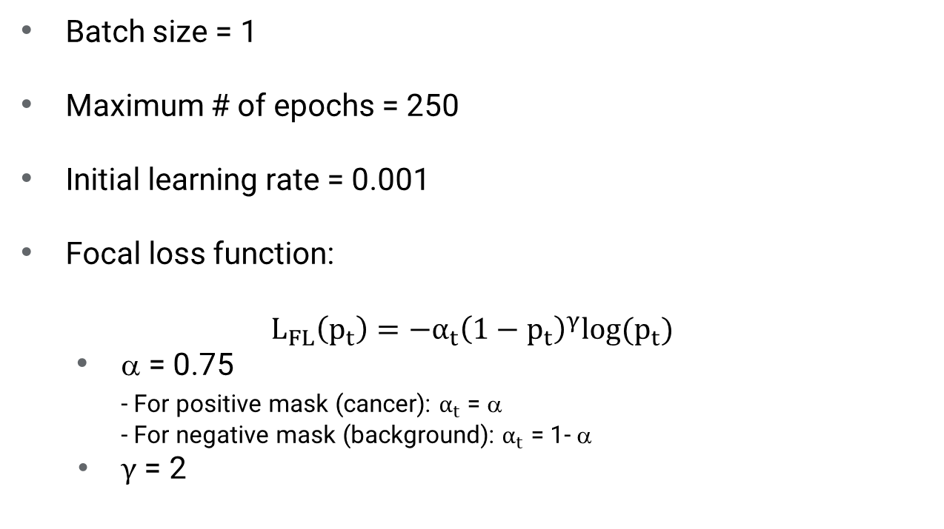
Training Process
Batch size = 1
Maximum # of epochs = 250
Initial learning rate = 0.001
Focal loss function:
$$L_{FL}\left(p_{t}\right)=−α_{t}{\left(1−p_{t}\right)}^{γ}\text{log}(p_{t})$$
α = 0.75
- For positive mask (cancer): $α_{t}$ = α
- For negative mask (background): $α_{t}$ = 1- α
$γ$ = 2

Slide 12
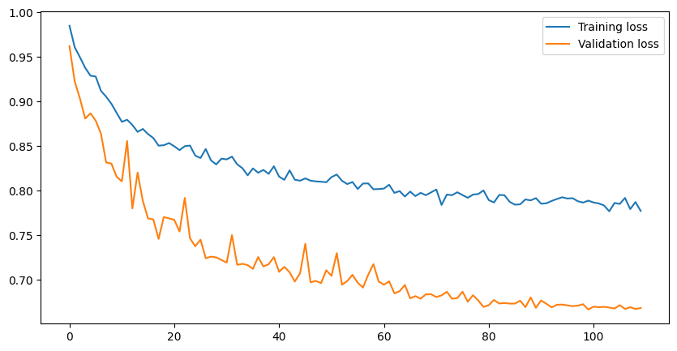
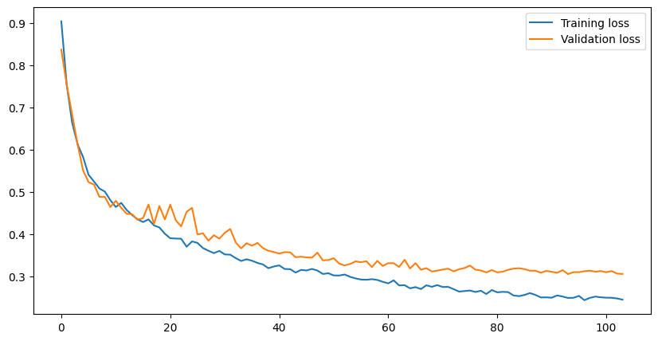
Training loss
Validation Loss
Model 1
ComboLoss
99
Model 2
ComboLoss
Layer Norm
93

Slide 13
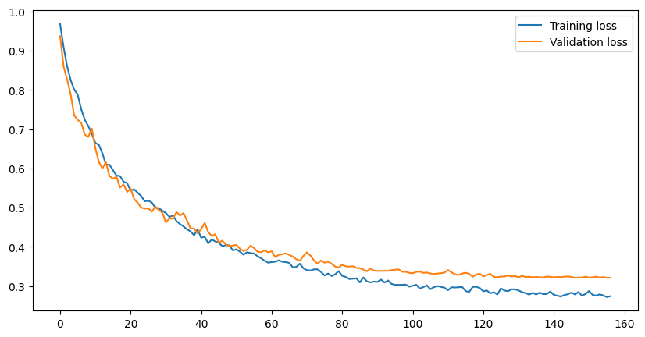
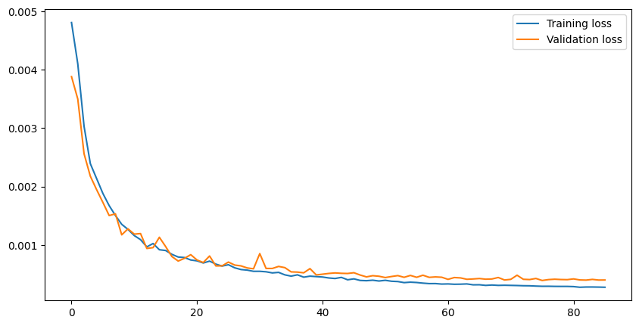
0.9
Training loss
Validation Loss
0.8
Model 2
ComboLoss
Layer Norm
0.7
0.6
93
0.5
0.4
0.3
0
20
40
60
80
100
1.0
0.9
Model 3
Dice Loss
Layer Norm
0.8
0.7
146
0.6
0.5
0.4
0.3
0
20
40
60
80
100
120
140
160
0.005
Model 4
Focal Loss
Layer Norm
0.004
0.003
75
0.002
0.001
0
20
40
60
80

Slide 14
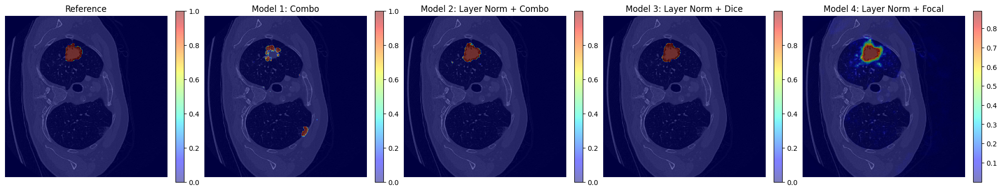
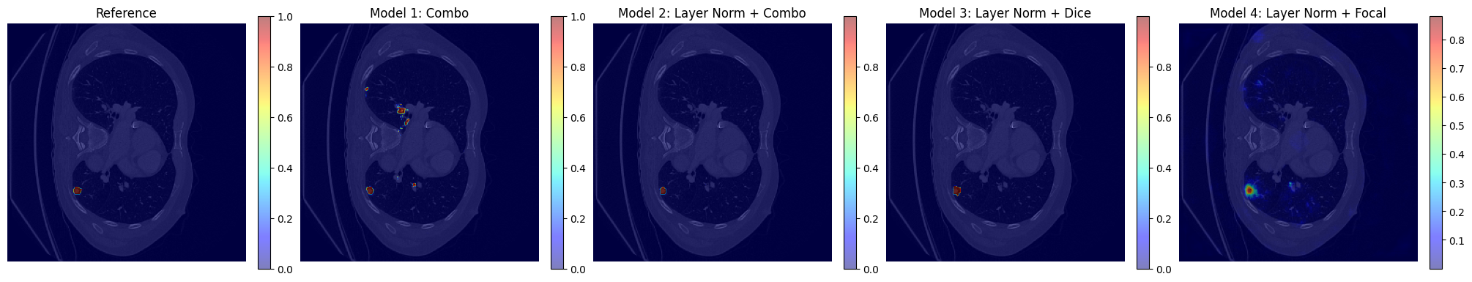
Raw Output (Validation Set)
sample 1 from validation set
sample 2 from validation set

Slide 15
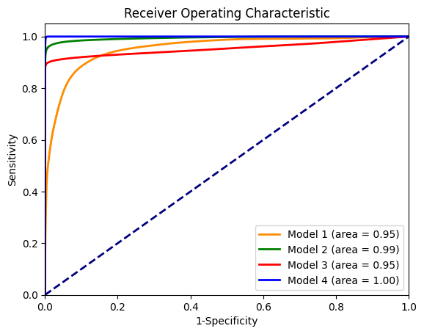
ROC (Training Set)

Slide 16
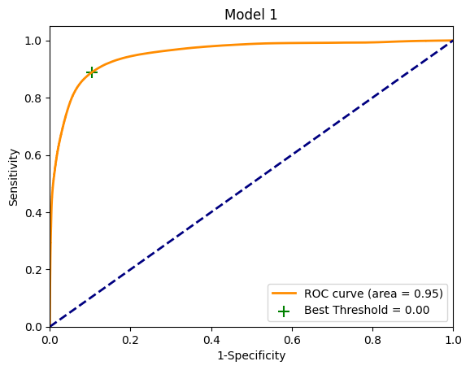
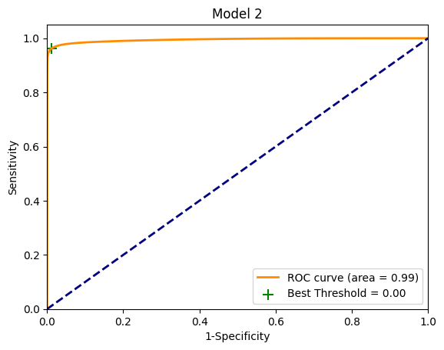
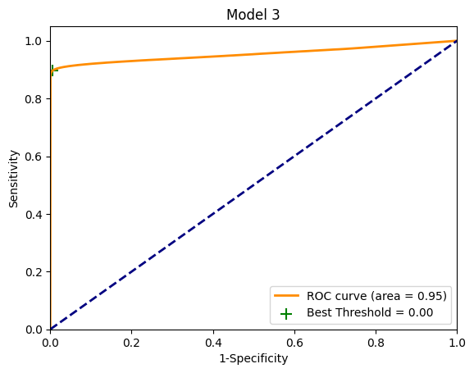

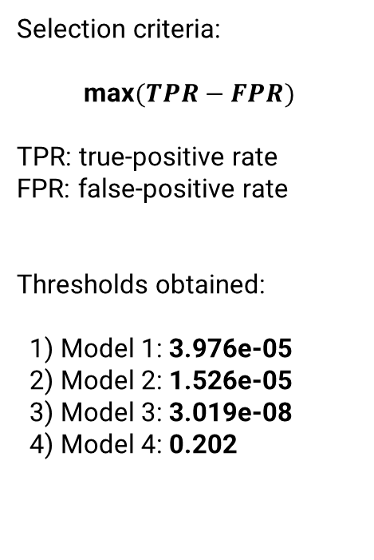
Threshold Selection (Training Set)
Selection criteria:
$$\text{max}(TPR−FPR)$$
TPR: true-positive rate
FPR: false-positive rate
Thresholds obtained:
1) Model 1: 3.976e-05
2) Model 2: 1.526e-05
3) Model 3: 3.019e-08
4) Model 4: 0.202

Slide 17
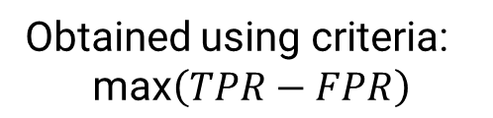
Threshold Selection (Training Set)
Model# Method Thresh Dice TPR FPR
Model 1 tpr-fpr 0.000 0.080 0.854 0.104
Model 2 tpr-fpr 0.000 0.496 0.887 0.012
Model 3 tpr-fpr 0.000 0.529 0.821 0.005
Model 4 tpr-fpr 0.202 0.619 0.980 0.004
Obtained using criteria:
$$\text{max}\left(TPR−FPR\right)$$
Dice scores are relatively low

Slide 18
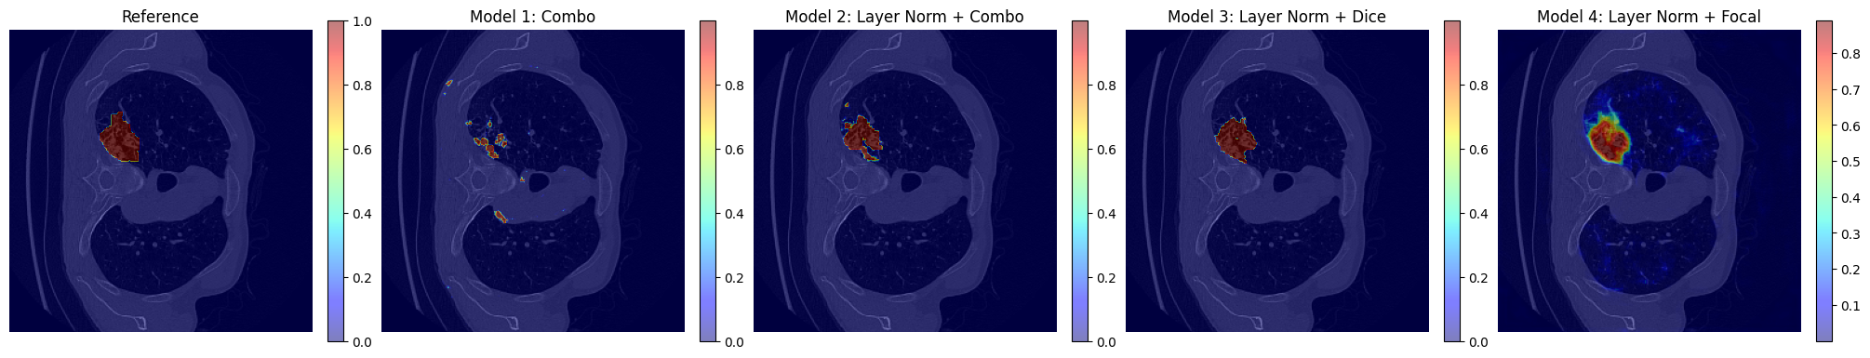
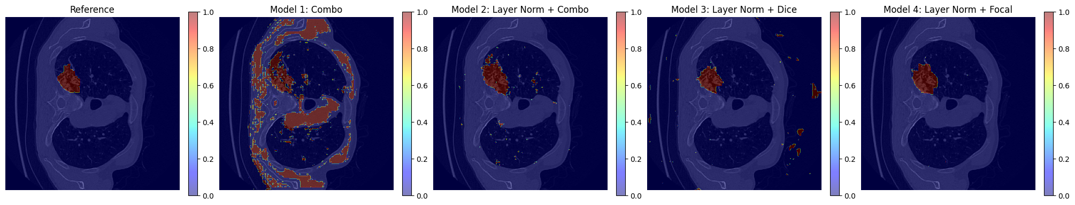
Threshold Outputs (Validation Set)
Raw Output
After Thresholding
Dice Score:
0.147
0.738
0.695
0.852

Slide 19
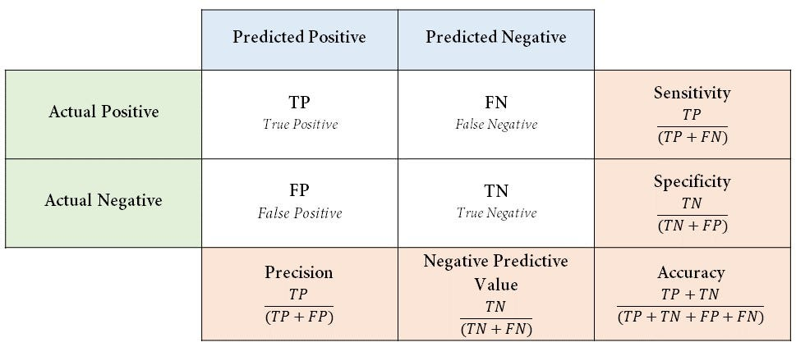
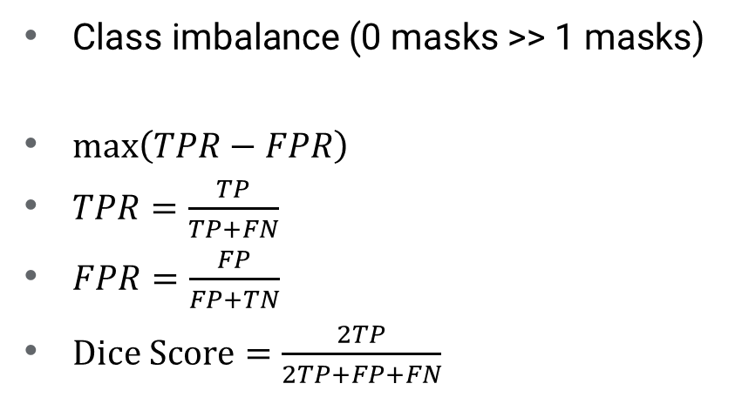
Class Imbalance Issue
$\text{Class} \text{imbalance}\text{ (0 }\text{masks}\text{ >> 1 }\text{masks}\text{)}$
$\text{max}\left(TPR−FPR\right)$
$TPR=\frac{TP}{TP+FN}$
$FPR=\frac{FP}{FP+TN}$
$\text{Dice} \text{Score}=\frac{2TP}{2TP+FP+FN}$
Notes:
Thresholds are low to satisfy the condition of maximizing the difference between tpr and fpr
TPR becomes high, FPR becomes small. Due to class imbalance, FPR is still small with significant amount of FP (as you can see in the plots)

Slide 20
Threshold Selection (Training Set)
New selection criteria: Max(Dice score)
Create a list of thresholds: 0 to 1 with 0.1 intervals
[0.0, 0.1, 0.2, …, 0.9, 1.0]
Calculate average dice score
Select the threshold

Slide 21
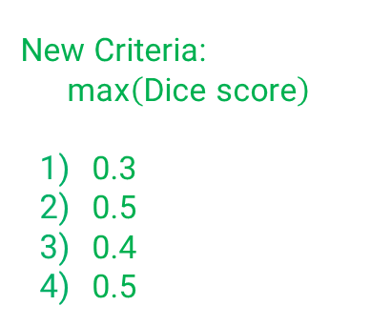
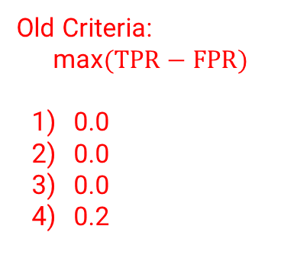
Threshold Selection (Training Set)
Model# Method Thresh Dice TPR FPR
Model 1 tpr-fpr 0.000 0.080 0.854 0.104
Model 1 Dice 0.300 0.378 0.453 0.004
Model 2 tpr-fpr 0.000 0.496 0.887 0.012
Model 2 Dice 0.500 0.786 0.800 0.001
Model 3 tpr-fpr 0.000 0.529 0.821 0.005
Model 3 Dice 0.400 0.769 0.777 0.001
Model 4 tpr-fpr 0.202 0.619 0.980 0.004
Model 4 Dice 0.500 0.804 0.877 0.001
Old Criteria:
$$\text{max}(TPR−FPR)$$
0.0
0.0
0.0
0.2
New Criteria:
$$\text{max}\left(\text{Dice} \text{score}\right)$$
0.3
0.5
0.4
0.5

Slide 22
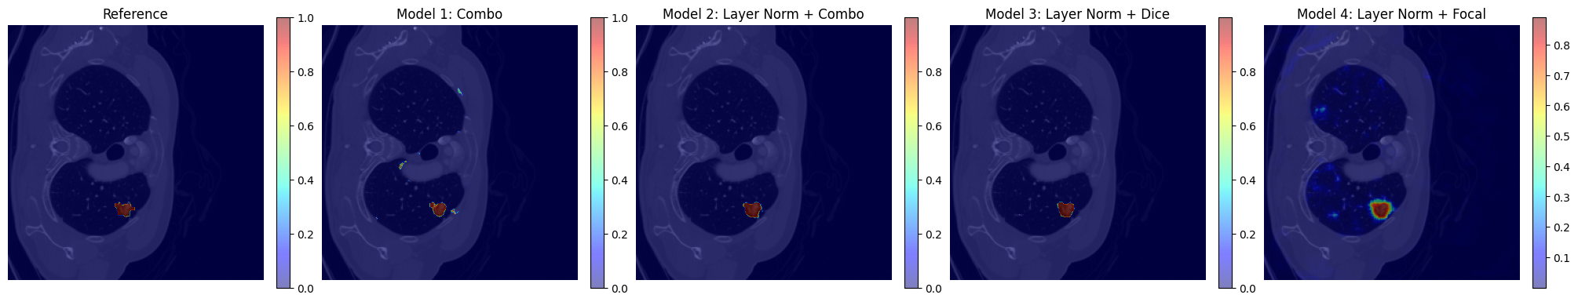
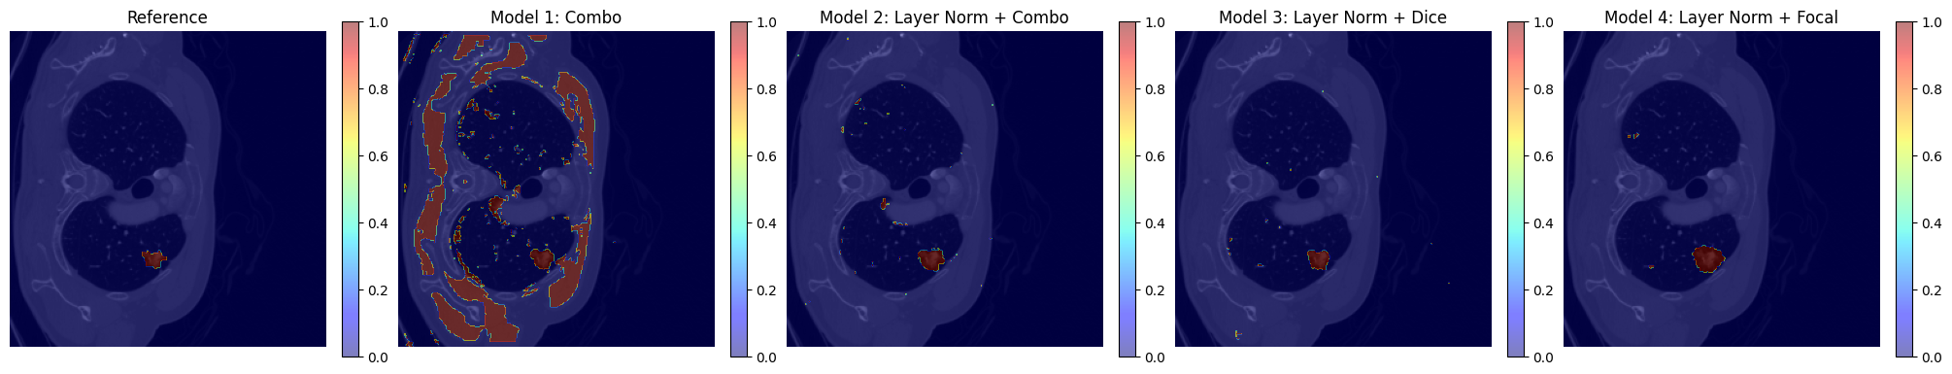
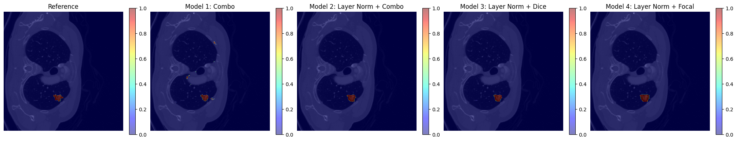
Threshold Selection (Training Set)
Raw
Max(tpr-fpr)
Max(Dice)

Slide 23
Test Results (Test Set)
Model# Method Thresh Dice TPR FPR
Model 1 tpr-fpr 0.000 0.074 0.875 0.105
Model 1 Dice 0.300 0.390 0.487 0.003
Model 2 tpr-fpr 0.000 0.478 0.850 0.011
Model 2 Dice 0.500 0.731 0.727 0.001
Model 3 tpr-fpr 0.000 0.492 0.778 0.005
Model 3 Dice 0.400 0.708 0.714 0.001
Model 4 tpr-fpr 0.202 0.588 0.922 0.004
Model 4 Dice 0.500 0.754 0.809 0.001

Slide 24
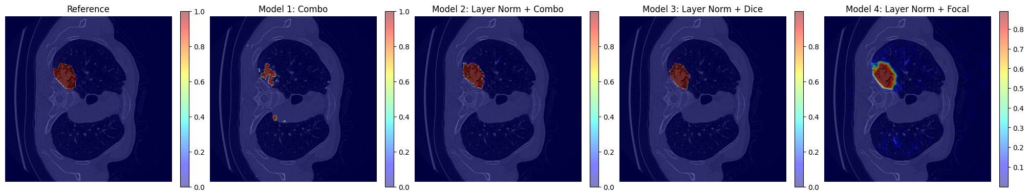
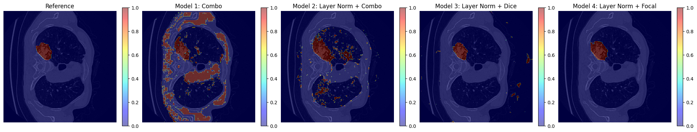
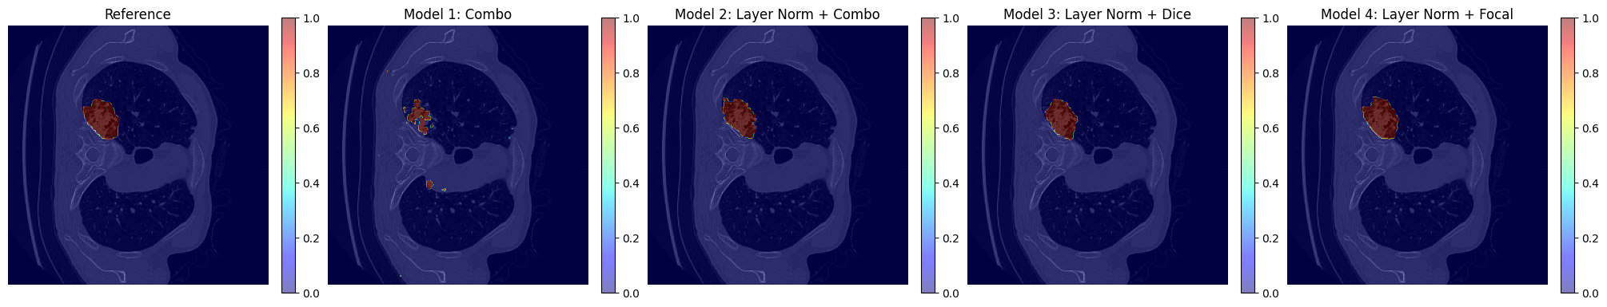
Test Results (Test Set)
Raw
Max(tpr-fpr)
Max(Dice)

Slide 25
Discussion
Data Augmentation
Limited amount of cancerous slices
More varieties and better generalization
Layer Normalization
Stabilize the model, smooth convergence
Significantly improves the results
Combining Dice & Focal
Convergence speed: Focal > Dice+Focal > Dice
Dice score: Focal > Dice+Focal > Dice
Future exploration: 𝛽*Focal + (1-𝛽)*Dice

Slide 26
Retrospective
Issues
Potential Improvements
Dataset was already preprocessed (only axial plane, lost metadata)
Chose another dataset and preserve metadata to calculate tumor size
2D U-Net struggled to distinguish blood vessels
3D U-Net using patches or slabs
Only used cancerous slices
Design pipelined process to select cancerous slices
Current batch size = 1
Increase batch size and batch normalization
Non-ideal Dice score
K-fold cross validation

Slide 27
Questions?
Roy Huang
University of Iowa Electrical and Computer Engineering Department
Daniel Meggo
University of Iowa Biomedical Engineering Department
Jordan Mimms
University of Iowa Biomedical Engineering Department
uiowa.edu

Slide 28
References
[1] Ferlay J, Ervik M, Lam F, Laversanne M, Colombet M, Mery L, Piñeros M, Znaor A, Soerjomataram I, Bray F (2024). Global Cancer Observatory: Cancer Today. Lyon, France: International Agency for Research on Cancer. Available from: https://gco.iarc.who.int/today, accessed [18 October 2024].
[2] American Cancer Society. Cancer Facts & Figures 2024. Atlanta: American Cancer Society; 2024.
[3] S. Rasouli (2023). Lung Cancer Segment [Data set]. Kaggle. https://www.kaggle.com/datasets/rasoulisaeid/lung-cancer-segment
[4] M. Antonelli, A. Reinke, S. Bakas, et al. “The Medical Segmentation Decathlon,” Nature Communications, vol. 13, no. 4128, 2022. https://doi.org/10.1038/s41467-022-30695-9
[5] O. Ronneberger, P. Fischer, T. Brox, (2015). “U-Net: Convolutional Networks for Biomedical Image Segmentation”. In: Navab, N., Hornegger, J., Wells, W., Frangi, A. (eds) Medical Image Computing and Computer-Assisted Intervention – MICCAI 2015. MICCAI 2015. Lecture Notes in Computer Science(), vol 9351.Springer ,
[6] Neville. (2023, July 21). Dice loss in Medical Image Segmentation. Medium. https://cvinvolution.medium.com/dice-loss-in-medical-image-segmentation-d0e476eb486
[7] T. -Y. Lin, P. Goyal, R. Girshick, K. He and P. Dollár, "Focal Loss for Dense Object Detection," in IEEE Transactions on Pattern Analysis and Machine Intelligence, vol. 42, no. 2, pp. 318-327, 1 Feb. 2020, doi: 10.1109/TPAMI.2018.2858826.

